Slide 1
Intro To Programming JavaScript

Slide 2
Brief Summary Of Chapter 8
What is a Function
Parameter and Arguments
Creating, Calling and Passing Arguments
Using a Return Statement
Making the Random Insult Generator into a Function
Chapter 8: Creating a Hangman Game

Slide 3
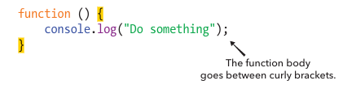
A function in JavaScript is a reusable block of code that performs a specific task. It helps simplify problems, improve readability, and avoid repetition by allowing you to write code once and use it multiple times. Functions keep your code organized, making it easier to understand and maintain. They are commonly used for tasks like handling user input, processing data, and performing calculations.
What is a Function?

Slide 4
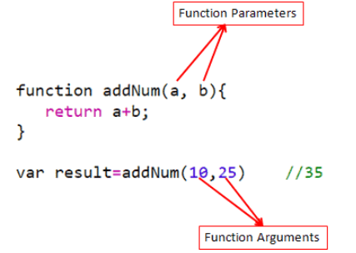
A parameter is a placeholder inside a function that tells it what kind of information it needs.
An argument is the actual value you give to the function when you use it.
Parameter and Arguments

Slide 5
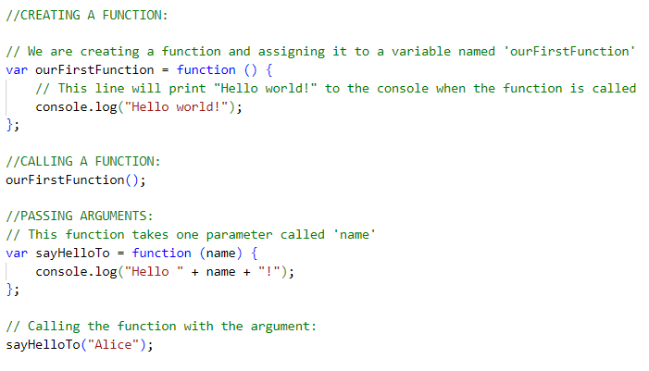
EXAMPLE: (B-p151 - 152 & L-p124 - 125)
Creating,Calling and Passing Arguments

Slide 6
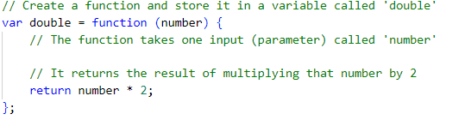
EXAMPLE: B-p157 & L-p130
The return statement gives something back from the function. It sends the result out, so you can use it somewhere else.
Without return, the function just does something (like printing a message). With return, it gives you a value.
Using a Return Statement

Slide 7
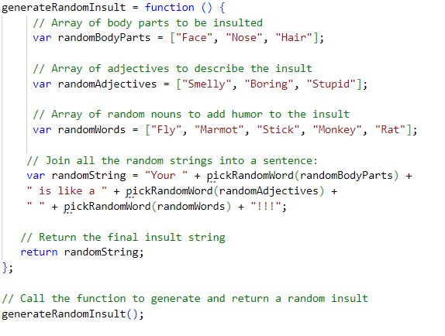
EXAMPLE: B-p161 & L-p134
Making the Random Insult Generator into a Function

Slide 8

Write a function that checks whether a name has at least six characters? (Check pages B-p162 & L-p135)
If the name has fewer than six characters, your function should exit early without doing anything further.
If the name has six or more characters, your function should return a string that tells you the sixth letter of the name.
Practice Exercises

Slide 9
Do the Programming Challenges then upload to github.
Page (B-165 - 167 & L-138 - 140)
Practice Exercises

Slide 10
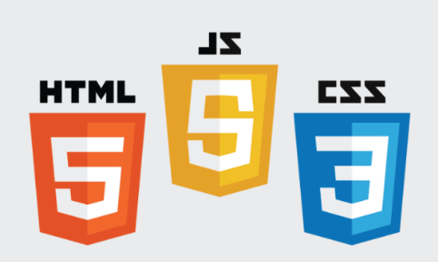
End Of Chapter 8

